Slide 1
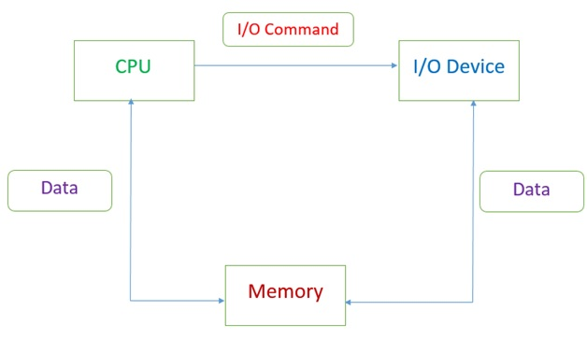
Memory Management

Slide 2
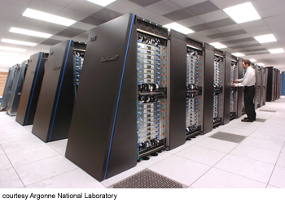

Memory Management
One of the most vital resources that a computer needs to manage is its memory.
All software runs in memory and all data is stored in some form of memory.
The quantity of memory can be vastly different depending on the type of computer.
For example the processing chip embedded in a chip and pin credit card will have a tiny amount of memory to hold its encrypted data, while a super-computer cluster will have petabytes of memory to manage (1 million gigabytes)

Slide 3
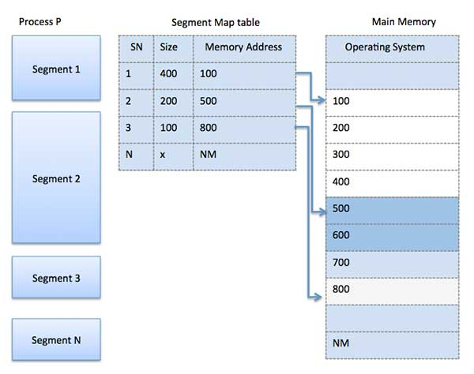
Memory Management
Memory management is necessary to organise the use of (main) memory by converting logical addresses to physical addresses.
Logical Address – address at which an item appears to reside, generated by CPU
Physical Address – the actual physical location of the storage cell in memory, generated by MMU
This allows programs to share memory and for memory to be allocated to other processes, which protects programs and data from each other and allows programs larger than main memory to run.

Slide 4
Reason for memory management
Every computer has a limited amount of memory and like any limited resource, memory needs to be managed.
This is the task of the memory manager (part of the operating system).
To run a process, it has to be loaded into main memory.
To run more than one process, they all have to be in main memory at the same time.

Slide 5
Reason for memory management
However, processes can write data into memory, so it's possible for one process to write over the memory holding a different process, causing it to become corrupted.
The memory manager tries to prevent this from happening.
It does this by giving each process its own segment of memory and not allowing them to write over other segments.

Slide 6
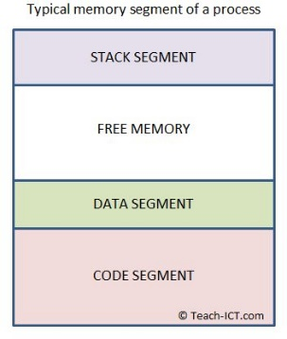
Segmentation
When an executable application is loaded into main memory it becomes a 'process’ and requires memory to run.
The operating system sets aside memory for the process to use, which is called 'segmentation’.
Segmentation is a way of partitioning memory. Segments are variable sizes based on contents and are logical divisions which hold complete sections of programs.
The memory segment given to the process is further divided into several sections - the 'stack segment', 'data segment', 'code segment' and 'free memory'.

Slide 7
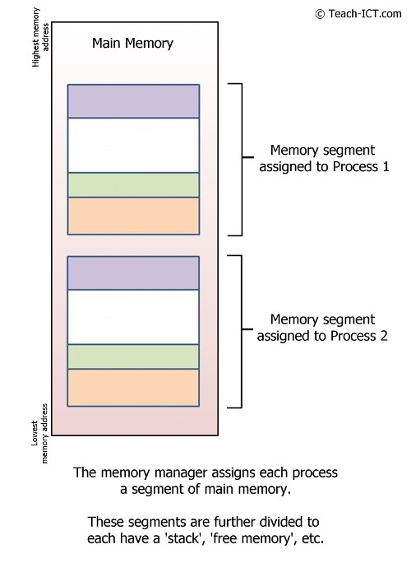
Segmentation
The diagram shows the memory manager loading several processes into main memory.
The memory manager is able to load and unload each process without affecting any of the others.

Slide 8
Paging
There is a second type of memory management task called paging, which is designed to handle virtual memory.
A page is a fixed sized physical division of memory.
Each page resides next to each other (contiguous).
The memory manager gives each page a number and records its location in a table, called a 'page table'.

Slide 9
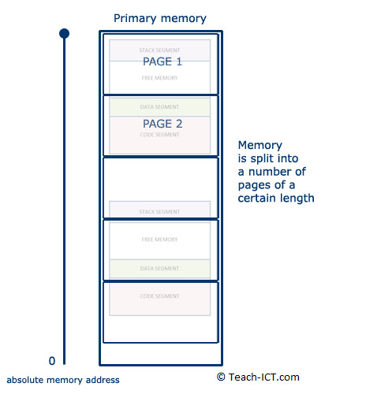
Pagination
Process memory segments can straddle several pages, like the second process segment shown in the diagram.

Slide 10
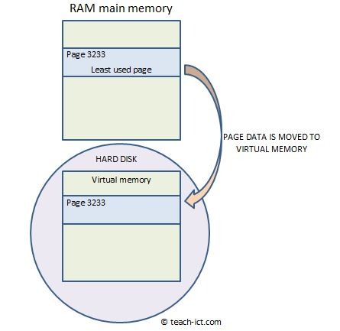
Pagination
When RAM is getting full, the memory manager can determine the least-used page.
This page is then copied down into virtual memory.
Page number 3233 happens to be moved into virtual memory in the diagram.

Slide 11
Pagination
The free area is re-numbered by the memory manager, and marked as free for use.
If at some point the content of page 3233 is needed once more, it is swapped back into RAM.
The memory manager is constantly juggling pages in and out of virtual memory.
Different segments of the same process can be on different pages and when the process is going to run, every page holding a segment of that process is moved into RAM at once.
Pagination is only done when virtual memory is being used – enough RAM = no pagination.

Slide 12
Segmentation vs Pagination
Similarities | Differences
Both are a way of dividing up memory but each method has different purpose. | A page is assigned a fixed size by the memory manager whilst the size of a segment varies
Both allow programs larger than memory to run | Paging deals with physical divisions in memory, whereas segmentation is diving memory logically
Both are managed by the memory manager within the OS | Pagination is used to swap data in and out of virtual memory whilst segmentation is used to load and unload processes
 | A page is not subdivided into smaller elements whilst segmentation has sub-elements of code, data, stack and free segments

Slide 13
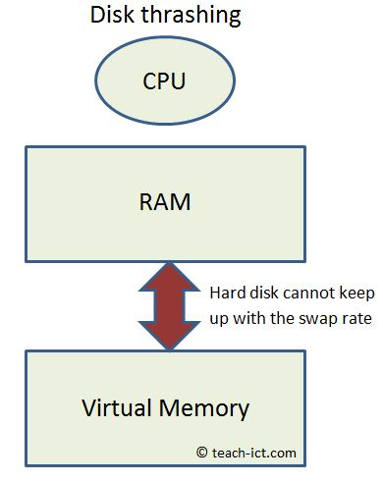
Disk Thrashing
Disk thrashing is a problem that may occur when virtual memory is in heavy use.
Compared to RAM speed, moving the head on a hard disk to a new location is thousands of times slower.
As more pages are swapped, eventually more time is spent swapping pages than on processing the data.
This is called disk thrashing.
The solution is to either install more RAM, or use fewer application at the same time.

Slide 14
Memory Leaks
A program will demand memory within a segment for storing its variables and data.
When a memory location is in use, the memory manager will mark it as being unavailable for any other process.
A well-written program will flush its data away once it no longer needs it.
It declares that the memory it was using is now free, and the memory manager can assign it for other processes to use.

Slide 15
Memory Leaks
Badly-written programs will not flush data properly.
The memory remains unavailable, locked up.
As the program continues to run, more and more memory gets locked up.
This is called a 'memory leak'.
If the leak is bad enough, then the system eventually runs out of memory.
Before that happens, the computer seems to run slower and slower.
Usually the only solution is to re-boot the computer to ensure all its memory has been cleared.

Slide 16
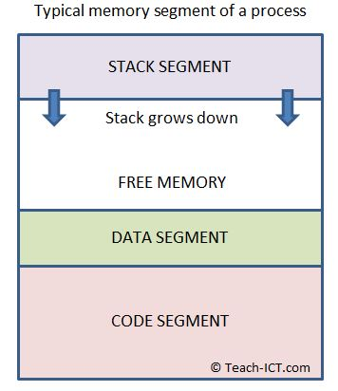
Stack Overflow
The diagram below shows the internal structure of a segment which you have seen in earlier.
Notice the stack can grow down towards the data segment.
It grows because every time a function calls another function, the address of the first is stored in the stack along with any parameters it uses.

Slide 17
Stack Overflow
But what if the new function now calls another? and that one calls yet another?
A poorly written or faulty program will cause the stack to 'overflow'.
A stack overflow means the stack has run out of free memory to expand into.
The program will usually crash at this point, possibly with a 'stack overflow' error message on screen.

